Slide 1
Syntax Analysis - I

Slide 2
Syntax Analyzer (Parser)
Syntax Analyzer creates a syntactic structure of the given source program.
This syntactic structure is mostly a parse tree.
The syntax of a programming language is described by a context-free grammar (CFG).
The Design of CFG is an initial phase of the design of a compiler.
The syntax analyzer (parser) checks whether a given source program satisfies the rules implied by a CFG or not.
  If it satisfies, the parser creates parse tree of that program; otherwise, gives error messages.

Slide 3
Parsing During Compilation
regular expressions
errors
lexical analyzer
token
rest of front end
intermediate representation
source program
parser
parse tree
get next token
symbol table
Collecting token information
Perform type checking
Intermediate code generation
use symbol table to check type of token
uses a grammar to check structure of input
produces a parse tree
syntactic errors and recovery
recognize correct syntax
report errors

Slide 4
Classification of Parsers
We categorize the parsers into two groups:
  Top-Down Parser
  Parse tree is created from top (the root) to bottom (leaves).
  Bottom-Up Parser
  Parse is created bottom (leaves) to top (the root).
Both top-down and bottom-up parsers scan the input from left to right, one symbol at a time.

Slide 5
Syntax Error Identification / Handling
Recall typical error types:
  Lexical : Misspellings [e.g. if x<1 thenn y = 5: ]
  Syntactic : Unbalanced parentheses [e.g. if ((x<1) & (y>5))) ]
  Semantic : Incompatible types, undefined IDs [e.g. if (x+5) then ]
  Logical : Infinite loop / recursive call
Majority of error processing (detection & recovery) occurs during the syntax analysis phase
NOTE: Not all errors are identifiable !!

Slide 6
Error Detection
Much responsibility on Parser
  Many errors are syntactic in nature
  Modern parsing method can detect the presence of syntactic errors in programs very efficiently
  Detecting semantic or logical error is difficult
Challenges for error handler in Parser
  It should report error clearly and accurately
  It should recover from error and continue..
  It should not significantly slow down the processing of correct programs
Good news is
  Common errors are simple and relatively easy to catch.
Errors don’t occur that frequently!!
    60% programs are syntactically and semantically correct
    80% erroneous statements have only 1 error, 13% have 2
    Most error are trivial : 90% single token error
    60% punctuation, 20% operator, 15% keyword, 5% other error

Slide 7
Adequate Error Reporting is Not a Trivial Task
Difficult to generate clear and accurate error messages.
Example-1:
  function foo (…) {
  ...
  if (...) {
  ...
  }
  else {
  ...
  ...
  }
Example-2:
  int myVarr;
  ...
  x = myVar;
  ...
Missing } here
Not detected until here
Misspelled ID here
Not detected until here

Slide 8
Error Recovery Approaches: Panic Mode
Discard tokens until we see a “synchronizing” token [e.g. ; or end].
Advantage
  Simple to implement
  Does not go into infinite loop
  Commonly used by most parsing method
Disadvantage
  May skip over large sections of source with some errors
Example
  Skip to next occurrence of
  } end ;
  Resume by parsing the next statement

Slide 9
Error Recovery Approaches: Phrase-Level Recovery
Compiler performs local corrects on the remaining input
[e.g. replacing , by ; or deleting an extraneous ; or inserting missing ; ]
Important
  - Replacement don’t lead to an infinite loop!!
Example
  while (x==4) y:= a + b
  Insert do to fix the statement

Slide 10
Context Free Grammars (CFG)
In a context-free grammar,
  A finite set of terminals T (i.e. set of tokens)
  A finite set of non-terminals V (i.e. set of syntactic-variables)
  A finite set of productions rules in the following form
    A → α where A∈V and α∈V∪T
  A start symbol (a non-terminal symbol)
Example:
  E → E + E | E – E | E * E | E / E | - E
  E → ( E )
  E → id

Slide 11
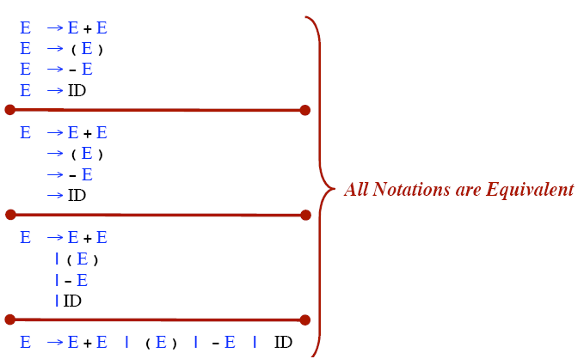
Rule Alternative Notations

Slide 12
Example of CFG: Simple Arithmetic Expressions
Production rules
expr → expr op expr
expr → ( expr )
expr → - expr
expr → id
op → +
op → -
op → *
op → /
op → ↑
Terminals: id + - * / ↑ ( )
Nonterminals: expr, op
Start symbol: expr

Slide 13
Notational Conventions
Terminals
  Lower-case letters early in the alphabet: a, b, c
  Operator symbols: +, -
  Punctuations symbols: parentheses, comma
  Boldface strings: id or if
Nonterminals:
  Upper-case letters early in the alphabet: A, B, C
  The letter S (start symbol)
  Lower-case italic names: expr or stmt
Upper-case letters late in the alphabet, such as X, Y, Z, represent either nonterminals or terminals (grammar symbol).
Lower-case letters late in the alphabet, such as u, v, …, z, represent strings of terminals.

Slide 14
Notational Conventions
Lower-case Greek letters, such as α, β, γ, represent strings of grammar symbols. Thus A→ α indicates that there is a single nonterminal A on the left side of the production and a string of grammar symbols α to the right of the arrow.
If A→ α₁, A→ α₂, …., A→ α_{k} are all productions with A on the left, we may write A→ α₁ | α₂ | …. | α_{k}
Unless otherwise stated, the left side of the first production is the start symbol.
Example: Applying these shorthand to previous example of CFG,
E → E A E | ( E ) | -E | id
A → + | - | * | / | ↑

Slide 15
Derivations
In general, a derivation step is
  αAβ ⇒ αγβ if there is a production rule A→γ
  α and β are arbitrary strings of terminal and non-terminal symbols
If α₁ ⇒ α₂ ⇒ ... ⇒ α_{n} , then “α_{n} is derived from α₁“ or “α₁ derives α_{n}”)
⇒ : derives in one step
⇒ : derives in zero or more steps
⇒ : derives in one or more steps
*
+

Slide 16
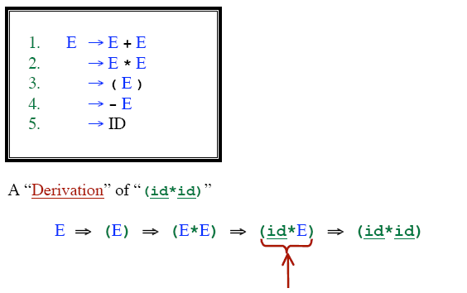
Example of Derivations
*

Slide 17
CFG - Terminology
L(G) is the language of G (the language generated by G) which is a set of sentences.
A sentence of L(G) is a string of terminal symbols of G.
If S is the start symbol of G then
  ω is a sentence of L(G) iff S ⇒ ω, where ω is a string of terminals of G.
If G is a context-free grammar, L(G) is a context-free language.
Two grammars G₁ and G₂ are equivalent if they produce the same language.
S ⇒ α - If α contains non-terminals, it is called as a sentential form of G.
- If α does not contain non-terminals, it is called as a sentence of G.
+
*

Slide 18
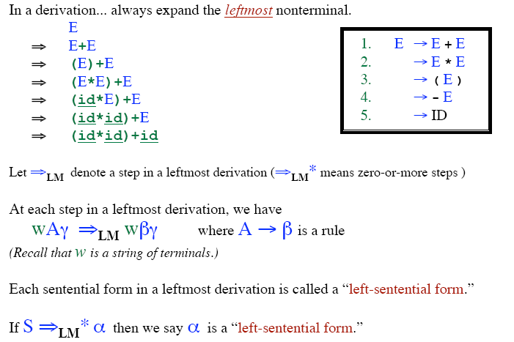
Leftmost Derivation

Slide 19
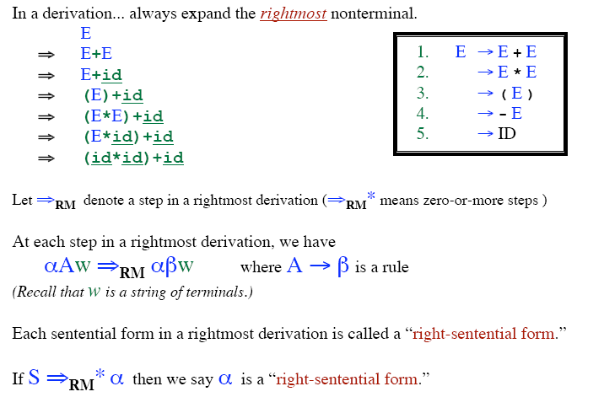
Rightmost Derivation

Slide 20
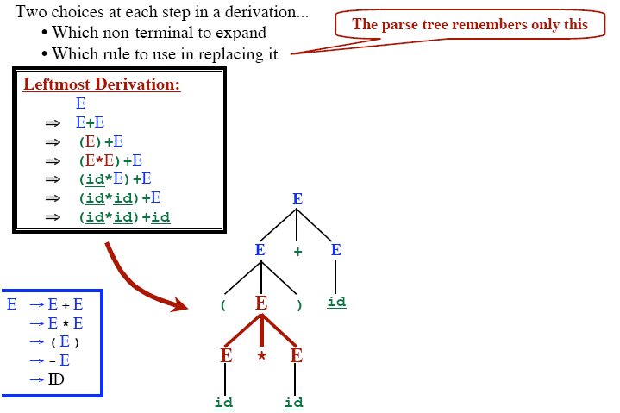
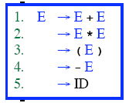
Parse Tree from Leftmost Derivation

Slide 21
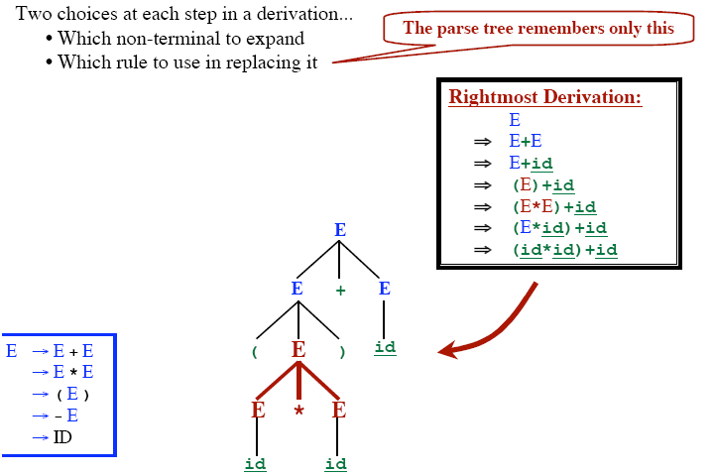
Parse Tree from Rightmost Derivation

Slide 22
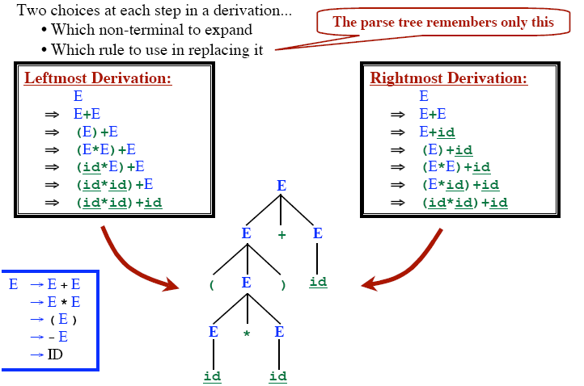
Parse Tree from Both Derivations

Slide 23
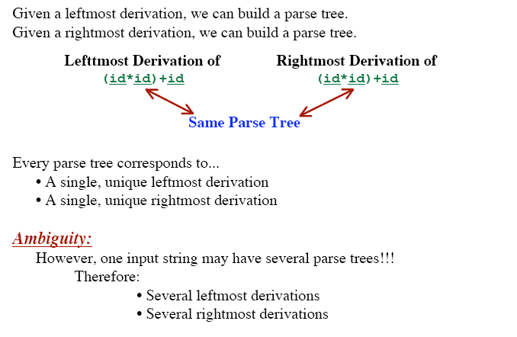
Parse Tree & Ambiguity

Slide 24
Ambiguous Grammar
A grammar produces more than one parse tree for a sentence is called as an ambiguous grammar.
For the most parsers, the grammar must be unambiguous.
Unambiguous grammar
➔ unique selection of the parse tree for a sentence
We should eliminate the ambiguity in the grammar during the design phase of the compiler.

Slide 25
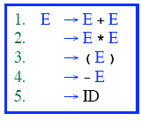
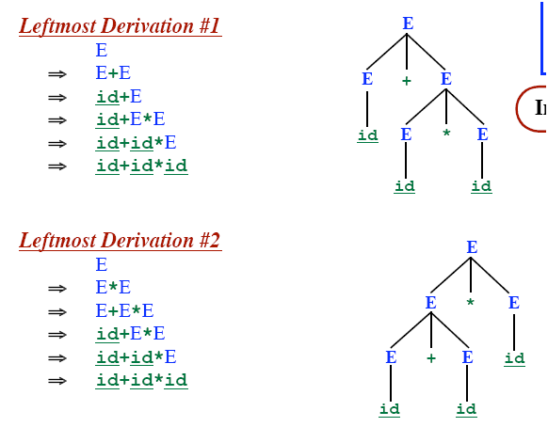

Ambiguous Grammar (Cont..)

Slide 26
Resolving Problems: Ambiguous Grammars
Consider the following grammar segment:
stmt → if expr then stmt
| if expr then stmt else stmt
| other (any other statement)
Simple parse tree:
if E1 then S1 else if E2 then S2 else S3
stmt
if
expr
then
stmt
else
stmt
E₁
S₁
expr
then
stmt
else
stmt
if
E₂
S₂
S₃

Slide 27
Example : What Happens with this string?
if E₁ then if E₂ then S₁ else S₂
How is this parsed ?
if E₁ then
if E₂ then
S₁
else
S₂
if E₁ then
if E₂ then
S₁
else
S₂
vs.

Slide 28
Parse Trees: if E1 then if E2 then S1 else S2
Form 1:
stmt
if
expr
then
stmt
E₁
stmt
else
stmt
if
expr
then
E₂
S₁
S₂
Form 2:
stmt
if
expr
then
stmt
else
stmt
E₁
expr
then
stmt
S₂
if
E₂
S₁

Slide 29
Removing Ambiguity
Consider original grammar
stmt → if expr then stmt
| if expr then stmt else stmt
| other (any other statement)
Rule: Match each else with the closest previous unmatched then.
Revise to remove ambiguity
stmt → matched_stmt | unmatched_stmt
matched_stmt → if expr then matched_stmt else matched_stmt | other
unmatched_stmt → if expr then stmt
| if expr then matched_stmt else unmatched_stmt

Slide 30
After Applying Previous Rule
if E1 then if E2 then S1 else S2
stmt
unmatched_stmt
if
expr
then
stmt
E₁
matched_stmt
if
expr
then
matched_stmt
else
matched_stmt
E₂
S₁
S₂

Slide 31
Left Recursion
A grammar is left recursive if it has a non-terminal A such that there is a derivation A ⇒ Aα for some string α
Top-down parsing techniques cannot handle left-recursive grammars.
So, we have to convert the left-recursive grammar into an equivalent grammar which is not left-recursive.
The left-recursion may appear in a single step of the derivation (immediate left-recursion), or may appear in more than one step of the derivation.
+

Slide 32
Immediate Left-Recursion
A → A α | β where β does not start with A
eliminate immediate left recursion by replacing
the non-left-recursive production
A → β A’
A’ → α A’ | ε an equivalent grammar
⇓
In general,
A → A α₁ | ... | A α_{m} | β₁ | ... | β_{n} where β₁ ... β_{n} do not start with A
A → β₁ A’ | ... | β_{n} A’
A’ → α₁ A’ | ... | α_{m} A’ | ε an equivalent grammar
⇓
eliminate immediate left recursion

Slide 33
Immediate Left-Recursion -- Example
E → E+T | T
T → T*F | F
F → (E) | id
Derive : id + id + id
E ⇒ T E’
⇒ F T’ E’
⇒ id T’ E’
⇒ id E’
⇒ id + T E’
⇒ ….
⇒ id + id + id
eliminate immediate
left recursion
⇓
E → T E’
E’ → +T E’ | ε
T → F T’
T’ → *F T’ | ε
F → (E) | id

Slide 34
Left-Recursion -- Problem
A grammar may not be immediately left-recursive, but it still
can be left-recursive.
By just eliminating the immediate left-recursion, we may not
get a grammar which is not left-recursive.
Example:
}
This grammar is not immediately left-
recursive, but it is still left-recursive.
S → Aa | b
A → Sc | d
S ⇒ Aa ⇒ Sca or
A ⇒ Sc ⇒ Aac causes to a left-recursion
So, we have to eliminate all left-recursions from the grammar.
⇓

Slide 35
Eliminate Left-Recursion -- Algorithm
- Arrange non-terminals in some order: A₁ …... A_{n}
- for i from 1 to n do {
- for j from 1 to i-1 do {
replace each production
A_{i} → A_{j} γ
by
A_{i} → α₁ γ | ... | α_{k} γ where A_{j} → α₁ | ... | α_{k}
}
- eliminate immediate left-recursions among A_{i} productions
}
Note: This algorithm works properly for the grammar without
no cycle or e-productions.

Slide 36
Eliminate Left-Recursion – Example 1
S → Aa | b
A → Ac | Sd | f
For S:
- there is no immediate left recursion in S.
For A:
- Replace A → Sd with A → Aad | bd
- So, we will have A → Ac | Aad | bd | f
- Eliminate the immediate left-recursion in A
A → bdA’ | fA’
A’ → cA’ | adA’ | ε
The resulting equivalent grammar which is not left-recursive is:
S → Aa | b
A → bdA’ | fA’
A’ → cA’ | adA’ | ε
- Order of non-terminals: S, A

Slide 37
Eliminate Left-Recursion – Example2
S → Aa | b
A → Ac | Sd | f
For A:
- Eliminate the immediate left-recursion in A
A → SdA’ | fA’
A’ → cA’ | ε
For S:
- Replace S → Aa with S → SdA’a | fA’a
- So, we will have S → SdA’a | fA’a | b
- Eliminate the immediate left-recursion in S
S → fA’aS’ | bS’
S’ → dA’aS’ | ε
The resulting equivalent grammar which is not left-recursive is:
S → fA’aS’ | bS’
S’ → dA’aS’ | ε
A → SdA’ | fA’
A’ → cA’ | ε
- Order of non-terminals: S, A

Slide 38
Removing ∈-Moves
Transformation: In order to remove A→∈ find all rules of
the form B→ uAv and add the rule B→ uv
to the grammar G.
Examples:
A grammar is ∈-free if:
It has no ∈-production or
There is exactly one ∈-production
S → ∈ and then the start symbol S does not appear on the right side of any production.
A₁ → A₂ a | b
A₂ → bd A₂’ | A₂’
A₂’ → c A₂’ | bd A₂’ | ∈

Slide 39
Removing Cycles
How would cycles be removed ?
- Make sure every production is adding some terminal(s)
(except a single ∈ -production in the start NT)…
Example:
S → SS | ( S ) | ∈
Has a cycle:
S ⇒ SS ⇒ S
Transform to:
S → S ( S ) | ( S ) | ∈
S → ∈

Slide 40
Left-Factoring
A predictive parser (a top-down parser without backtracking) insists that the grammar must be left-factored.
So, Grammar must be changed to a new equivalent grammar suitable for predictive parsing
Example:
stmt → if expr then stmt else stmt |
if expr then stmt
when we see if, we don’t know which production rule to choose to re-write stmt in the derivation.

Slide 41
Left Factoring: Example-1
Problem : Uncertain which of 2 rules to choose
stmt → if expr then stmt else stmt
| if expr then stmt
What’s the general form of stmt ?
A → αβ₁ | αβ₂ α : if expr then stmt
β₁: else stmt
β₂ : ∈
Transform to:
A → α A’
A’ → β₁ | β₂
EXAMPLE:
stmt → if expr then stmt rest
rest → else stmt | ∈

Slide 42
Left-Factoring -- Algorithm
For each non-terminal A with two or more alternatives (production rules) with a common non-empty prefix,
let say -
A → αβ₁ | ... | αβ_{n} | γ₁ | ... | γ_{m}
convert it into
A → αA’ | γ₁ | ... | γ_{m}
A’ → β₁ | ... | β_{n}

Slide 43
Left-Factoring – Example2
A → ad | a | ab | abc | b
⇓
A → aA’ | b
A’ → d | ε | b | bc
⇓
A → aA’ | b
A’ → d | ε | bA’’
A’’ → ε | c

